Slide 1
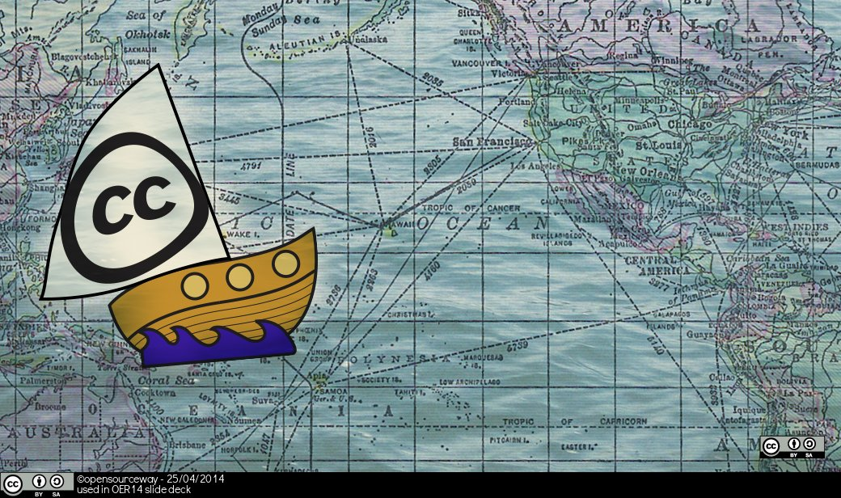
Creative Commons Licensing in Multiple Contexts (Moodle, MOOCs and FutureLearn)
Steve Stapleton
Senior Project Manager
University of Nottingham

Slide 2
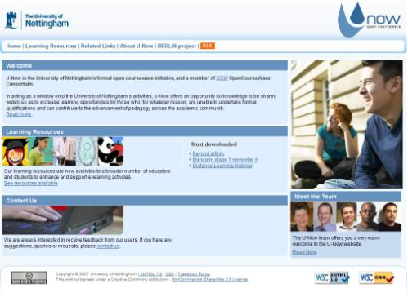
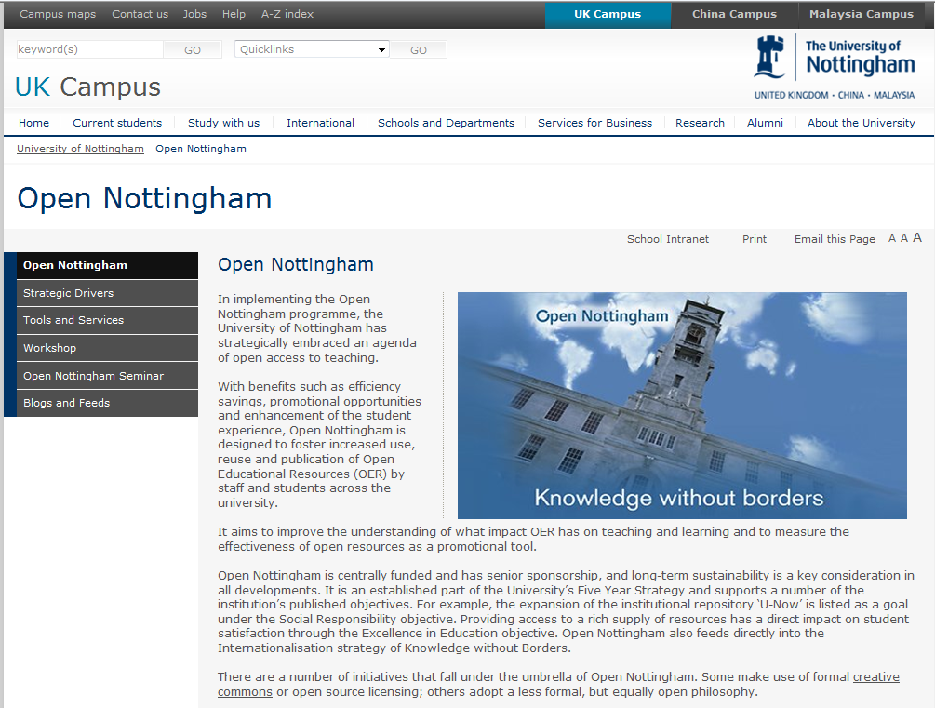
Timeline
U-Now – OCW/OER
Launched U-Now in 2007
Member of OCWC 2008
HEA/JISC funded through BERLiN project 2009/10
Open Nottingham 2010
Open learning publication
OER discovery & reuse
Open source tools

Slide 3
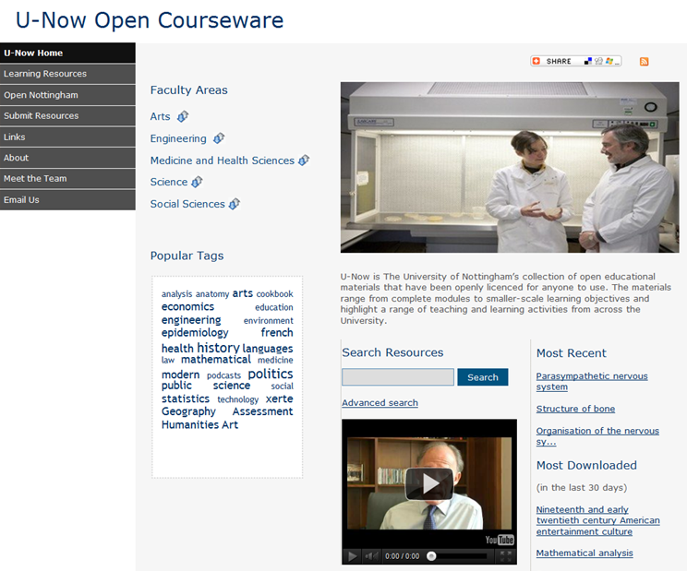
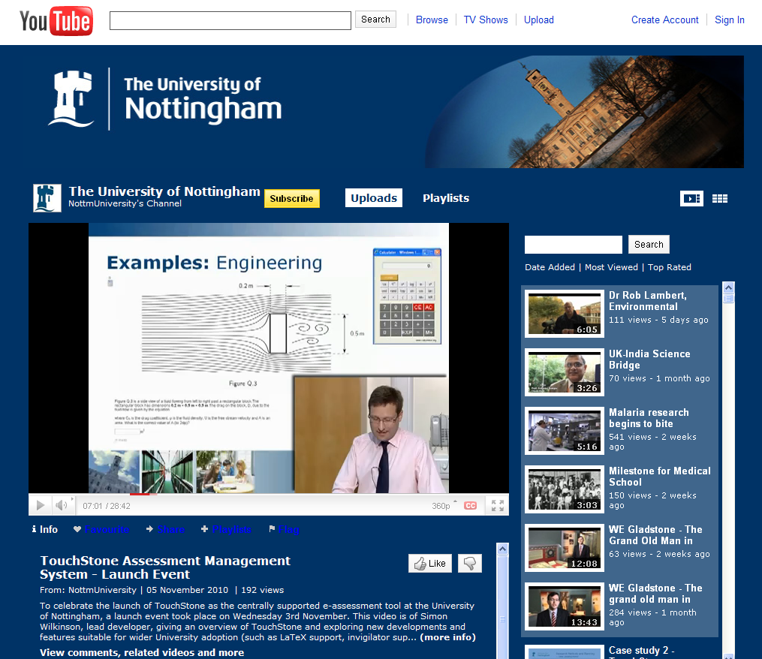
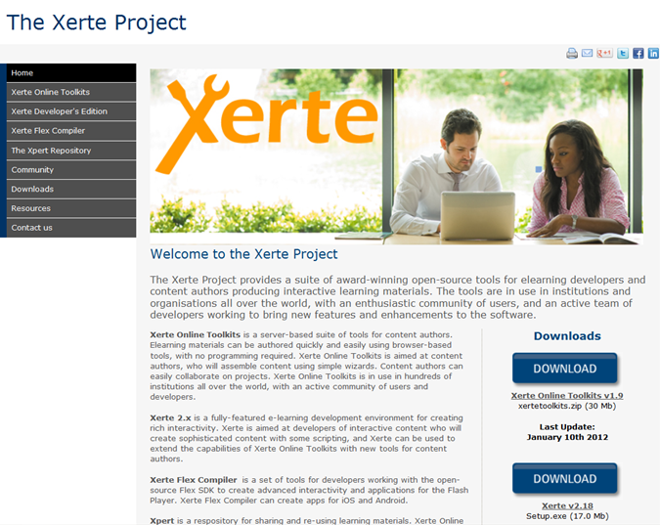
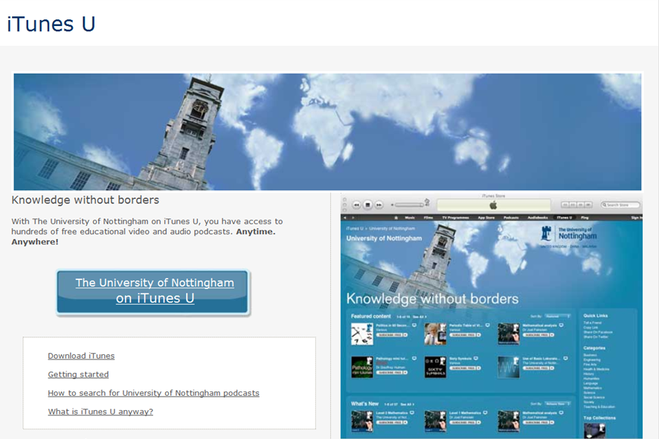
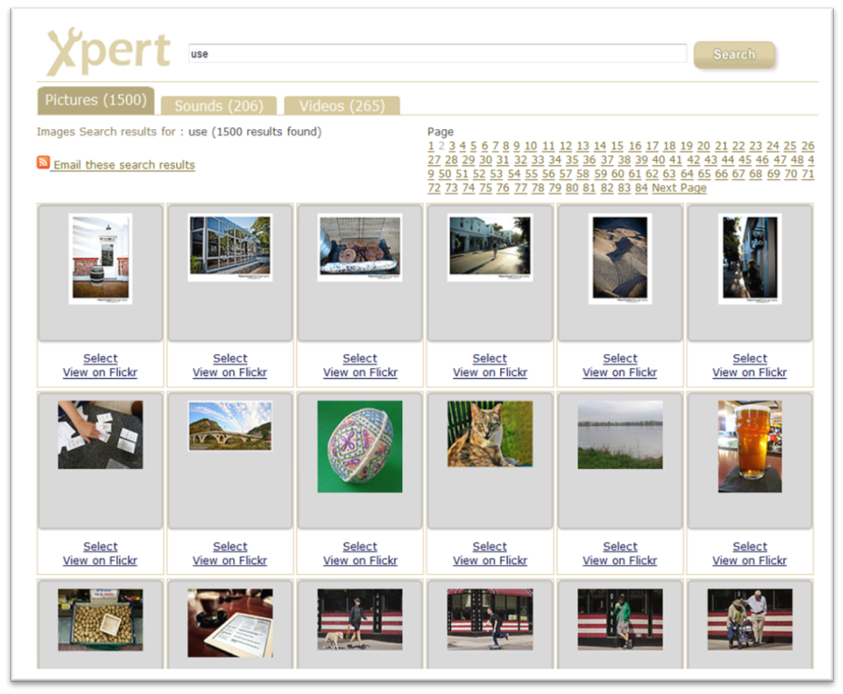
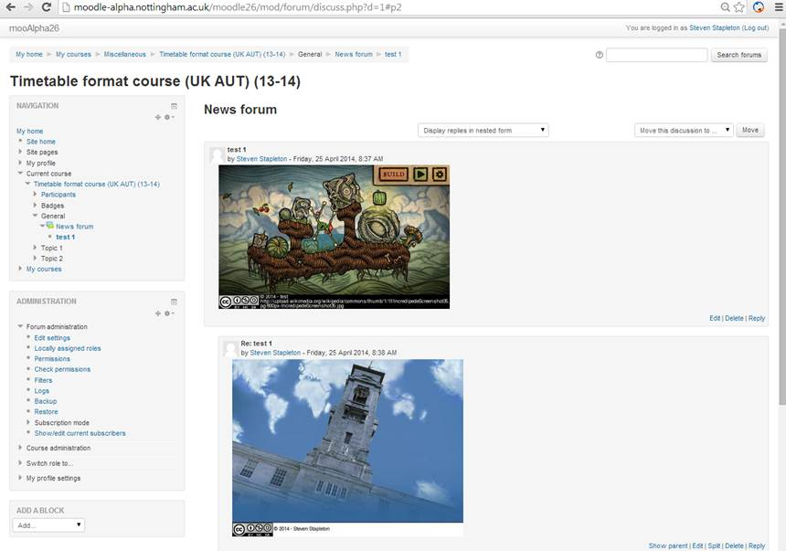
OER @ Nottingham

Slide 4
Moodle

Slide 5
3 Moodle plugins
Flickr Search and attribute the image
Upload and attribute the image
Specify a URL and attribute the image
http://moodle-alpha.nottingham.ac.uk/moodle26/course/view.php?id=3

Slide 6
3 Moodle plugins (JISC/HEA)
Flickr Search and attribute the image
- Returns only CC BY images
Upload and attribute the image
- all rights reserved option included
Specify a URL and attribute the image
- URL for the image (not the page)
http://moodle-alpha.nottingham.ac.uk/moodle26/course/view.php?id=3

Slide 7
FutureLearn (MOOC)
www.futurelearn.com
UK MOOC Provider
Private Company – set up by the OU
20+ institutional partners
British library
British Council
Courses launched Sept 2013
Statements of participation and exam based certificates

Slide 8
Why have we engaged with FL
Informing and improving online, distance and blended learning practices for registered students (NOOC – 3 campus)
Allows us to innovate and to learn (NOOC – 3 campus)
Showcasing Nottingham’s research and teaching excellence to a global audience
Recruitment to taught postgraduate courses
Engagement with alumni via CPD
Research partnerships
Provision of ‘Transition’ into/out of university courses
Conversion courses for applicants holding offers

Slide 9
Delivered 2 MOOCs on FutureLearn so far:
Sustainability, Society and You (8 week course, 5 hours per week)
How to read a mind (2 week course, 3 hours per week)
Two more are scheduled for 2014
Sustainability, Society and You (6 week course, 5 hours per week)
How to read your boss (2 week course, 3 hours per week)
High level of interest by schools and staff to run more – our focus is now on what our MOOC offering should be

Slide 10
Sustainability, Society and You
Based on OER first published in 2012 (U-Now & eBooks/iBooks)
60% of content was third party OER (text, images, video)
Released the course under a CC BY NC SA licence

Slide 11
Sustainability, Society and You
Variety of CC licence types re-used in the course
OER and MOOC design worked well for us
OER eBooks and iBooks download increased
For CC NC resources we contacted rights holders asking for permission to use within a MOOC that might charge for statements of participation
No rights holder said no to using their NC content (a few didn’t reply at all)
Some asked for changes to the attribution we had used
Some suggested other OER that might be useful to us

Slide 12
MOOC OER
How to read a mind was also published under CC licence
+ will be recommended for future courses (OER is opt in)
FutureLearn happy with courses as OER

